Slide 1
7

Slide 2
BA 310
  Tests Up Front…
  Check Gradesheet

Slide 3
Review of Last Class…
Midterm I

Slide 4
Today’s Class
Midterm I Discussion
Chapter 7 (Customer-Driven Mktg Strat)
Writing Exercise (Differentiation)
Midterm One Review (Optional)
  At End of Class, Go Over Answer Key
  Write “Appeals” on Notecards if Deserved, Possible “Bonus Points” for Successful Appeal

Slide 5
Chapter Seven
Customer-Driven Marketing Strategy:
Creating Value for Target Customers

Slide 6
Customer-Driven Marketing Strategy:
Creating Value for Target Customers
Topic Outline
Market Segmentation
Market Targeting
Differentiation and Positioning

Slide 7
Market Segmentation
Market segmentation is the process that companies use to divide large heterogeneous markets into small markets that can be reached more efficiently and effectively with products and services that match their unique needs

Slide 8
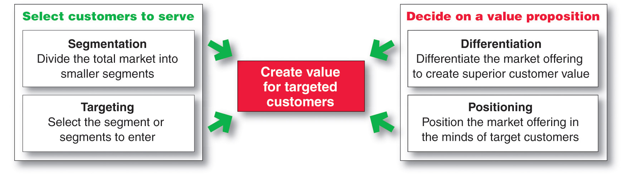
Market Segmentation

Slide 9
Market Segmentation
Segmenting consumer markets
Segmenting business markets
Segmenting international markets
Requirements for effective segmentation

Slide 10
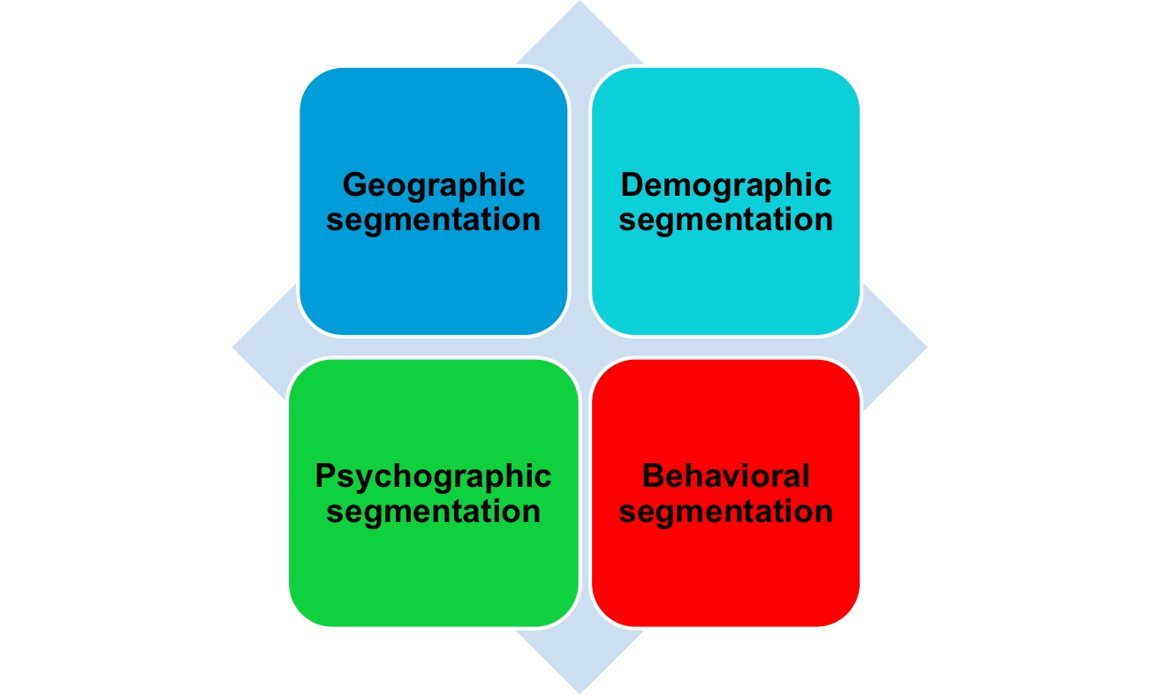
Market Segmentation
Segmenting Consumer Markets

Slide 11
Market Segmentation
Segmenting Consumer Markets
Geographic segmentation divides the market into different geographical units such as nations, regions, states, counties, or cities

Slide 12
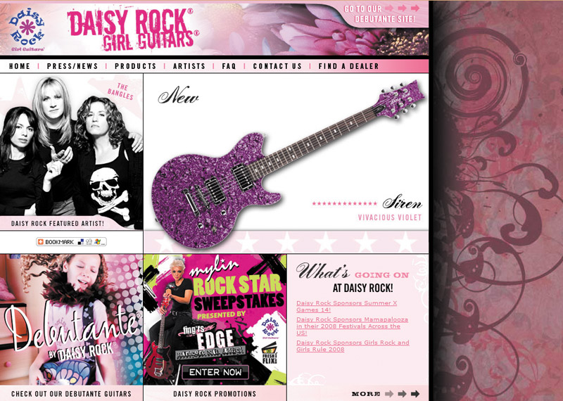
Market Segmentation
Segmenting Consumer Markets
Demographic segmentation divides the market into groups based on variables such as age, gender, family size, family life cycle, income, occupation, education, religion, race, generation, and nationality

Slide 13

Market Segmentation
Age and life-cycle stage segmentation is the process of offering different products or using different marketing approaches for different age and life-cycle groups
Gender segmentation divides the market based on sex (male or female)
Notes:
Note to Instructor
This link goes to gurl.com, a Web site for female teenagers and young adults. It is interesting to browse with the students to note what kind of content is of interest to this group. A look at the advertisers with banner ads, sponsorships, or contests on the site shows the importance of targeted locations to these advertisers.

Slide 14

Market Segmentation
Segmenting Consumer Markets
Income segmentation divides the market into affluent or low-income consumers
Psychographic segmentation divides buyers into different groups based on social class, lifestyle, or personality traits
Notes:
Note to Instructor
There are a whole group of products which are targeted to the affluent including hotels like Four Seasons, which is mentioned in the book.Their products offerings are deluxe:
Kids in the City package for $520 a night and, among other things, enjoy a visit in their room from the Ice Cream Man, who arrives with all the fixings to make any concoction they desire.
The Benjamin Hotel in New York City provides dog beds in a variety of styles and doggie bathrobes, as well as canine room service and DVDs for dogs.
At the Ritz-Carlton, Lake Las Vegas in Henderson, Nevada, the Love at Lake Las Vegas weekend package includes two nights in the 2,400 square foot presidential suite, helicopter and gondola rides, a champagne-tasting party on a yacht complete with rose petals strewn about and a string trio, use of a luxury car throughout the stay, in-room couples spa treatment, a $5,000 casino line of credit, a $50,000 shopping spree at Neiman Marcus, 14 dozen roses, and a butler-drawn Cristal champagne bath.

Slide 15

Market Segmentation
Segmenting Consumer Markets
Behavioral segmentation divides buyers into groups based on their knowledge, attitudes, uses, or responses to a product
Occasions
Benefits sought
User status
Usage rate
Loyalty status
Notes:
Note to Instructor
Students often get confused with the difference between behavioral and psychographic segmentation. Behavior is more tied into how consumers use the product. A good illustration is greeting cards—ask students how their purchasing would be different when buying a birthday card for their mother versus one for a new boyfriend. In addition, ask them how people might look for different benefits when purchasing a car? Some might look for safety while others will look for the best gas mileage.

Slide 16
Market Segmentation
Using Multiple Segmentation Bases
Multiple segmentation is used to identify smaller, better-defined target groups
Geodemographic segmentation is an example of multivariable segmentation that divides groups into consumer lifestyle patterns

Slide 17

Market Segmentation
Using Multiple Segmentation Bases
PRIZM NE classifies every American household into 66 unique segments organized into 14 different social groups.
These groups segment people and locations into marketable groups of like-minded consumers that exhibit unique characteristics and buying behavior based on a host of demographic factors

Slide 18
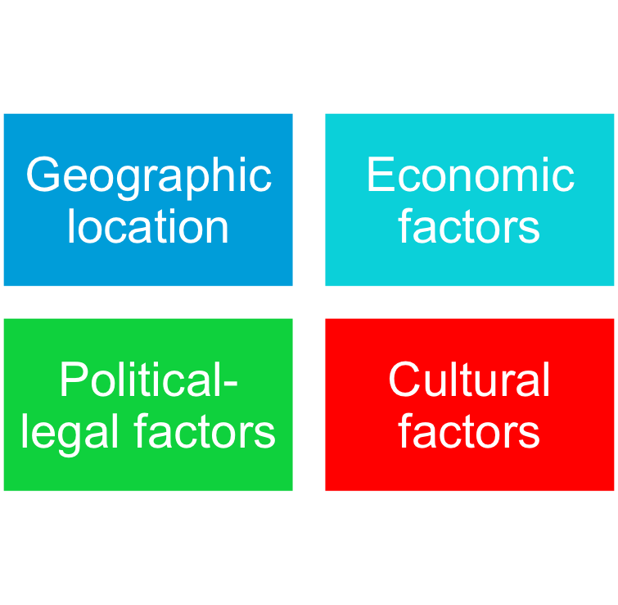
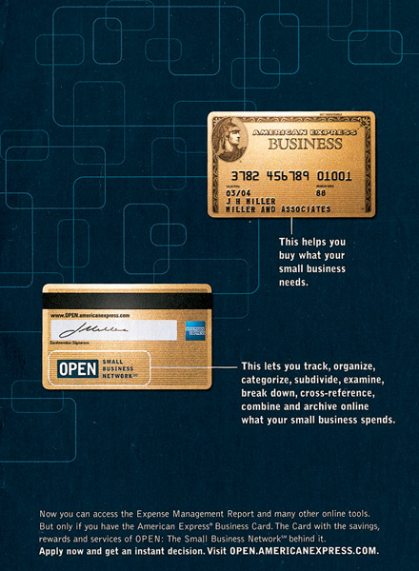
Market Segmentation
Segmenting International markets

Slide 19
Market Segmentation
Segmenting Business Markets
Intermarket segmentation divides consumers into groups with similar needs and buying behaviors even though they are located in different countries

Slide 20
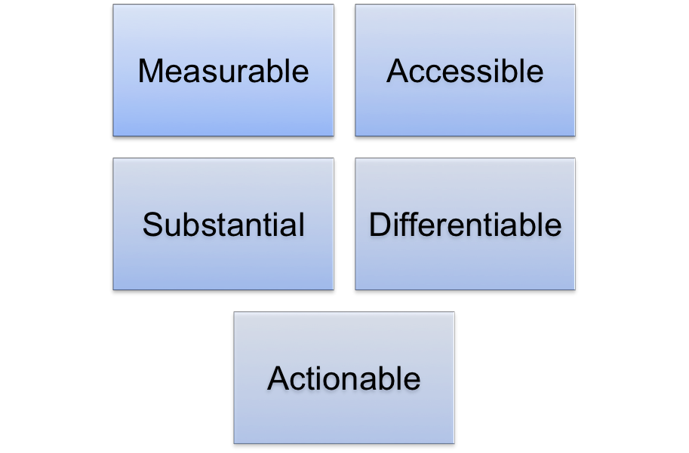

Market Segmentation
Requirements for Effective Segmentation
To be useful, market segments must be:

Slide 21
Market Targeting
Selecting Target Market Segments
Target market consists of a set of buyers who share common needs or characteristics that the company decides to serve

Slide 22
Market Targeting
Evaluating Market Segments
.
Segment size and growth
Segment structural attractiveness
Company objectives and resources
Notes:
Note to Instructor
Structural attractiveness includes factors that affect long-run attractiveness. These factors might include strong and aggressive competitors, substitute products, and high power of buyers or powerful suppliers.

Slide 23
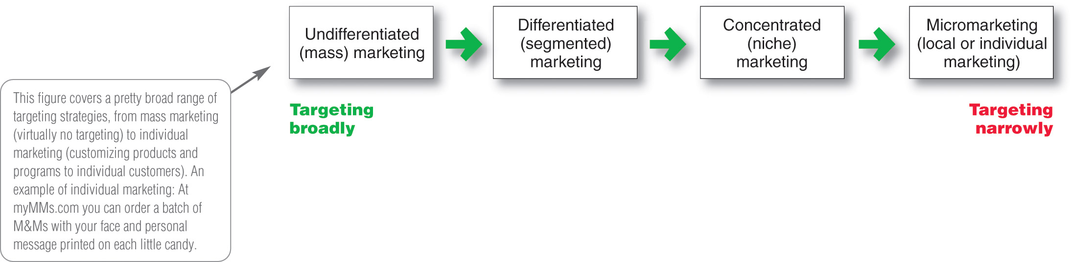
Market Targeting
Target Marketing Strategies

Slide 24
Market Targeting
Target Marketing Strategies
Undifferentiated marketing targets the whole market with one offer
  Mass marketing
  Focuses on common needs rather than what’s different

Slide 25
Market Targeting
Target Marketing Strategies
Differentiated marketing targets several different market segments and designs separate offers for each
Goal is to achieve higher sales and stronger position
More expensive than undifferentiated marketing

Slide 26

Market Targeting
Target Market Strategies
Concentrated marketing targets a small share of a large market
Limited company resources
Knowledge of the market
More effective and efficient

Slide 27

Marketing Targeting
Target Market Strategies
Micromarketing is the practice of tailoring products and marketing programs to suit the tastes of specific individuals and locations
Local marketing
Individual marketing
Notes:
Note to Instructor
In slideshow view, click on movie icon to launch Meredith video snippet. See accompanying DVD for full video segment.

Slide 28
Market Targeting
Target Market Strategies
Local marketing involves tailoring brands and promotion to the needs and wants of local customer groups
Cities
Neighborhoods
Stores
Notes:
Note to Instructor
Advances in communications technology have given rise to a new high-tech
version of location-based marketing. By coupling mobile phone services with GPS devices, many marketers are now targeting customers wherever they are with what they want. This might include marketers reaching people near their stores, looking to make a decision.
Discussion Question
What are the drawbacks of local marketing?
It can drive up manufacturing and marketing costs by reducing economies of scale. It can also create logistics problems as companies try to meet the varied requirements of different regional and local markets. Further, a brand’s overall image might be diluted if the product and message vary too much in different localities.

Slide 29
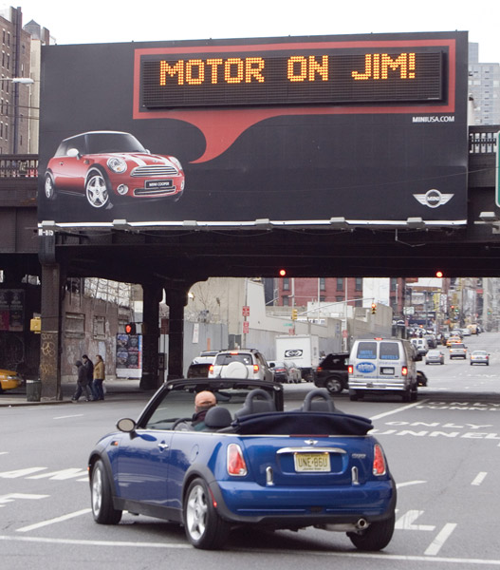
Market Targeting
Target Market Strategies
Individual marketing involves tailoring products and marketing programs to the needs and preferences of individual customers
Also known as:
  One-to-one marketing
  Mass customization
  Markets-of-one marketing
Notes:
Note to Instructor
Mass customization is the process through which firms interact one-to-one with masses of customers to design products and services tailor-made to meet individual needs.
Has made relationships with customers important in the new economy.
Provides a way to distinguish the company against competitors.

Slide 30
Market Targeting
Choosing a Target Market
Depends on:
Company resources
Product variability
Product life-cycle stage
Market variability
Competitor’s marketing strategies

Slide 31

Market Targeting
Socially Responsible Target Marketing
Benefits customers with specific needs
Concern for vulnerable segments
Children
  Alcohol
  Cigarettes
  Internet abuses

Slide 32
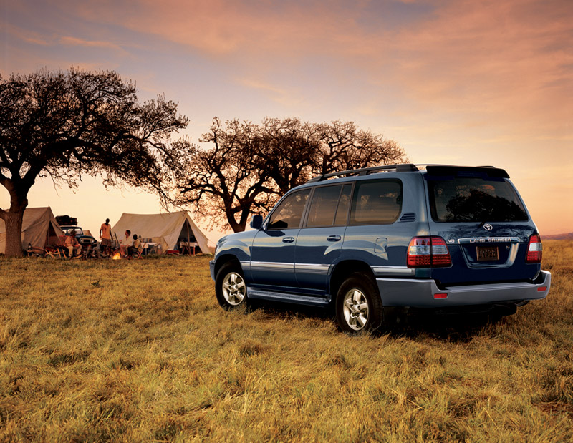
Differentiation and Positioning
Product position is the way the product is defined by consumers on important attributes—the place the product occupies in consumers’ minds relative to competing products
  Perceptions
  Impressions
  Feelings
Notes:
Note to Instructor
Tide is positioned as a powerful, all-purpose family detergent; Ivory is positioned as the gentle detergent for fine washables and baby clothes.
At Subway restaurants, you “Eat Fresh;” at Olive Garden, “When You’re Here, You’re Family;” and at Applebee’s you’re “Eatin’ Good in the Neighborhood.”
In the automobile market, the Nissan Versa and Honda Fit are positioned on economy, Mercedes and Cadillac on luxury, and Porsche and BMW on performance. Volvo positions powerfully on safety. And Toyota positions its fuel efficient, hybrid Prius as a high-tech solution to the energy shortage. “How far will you go to save the planet?” it asks.

Slide 33
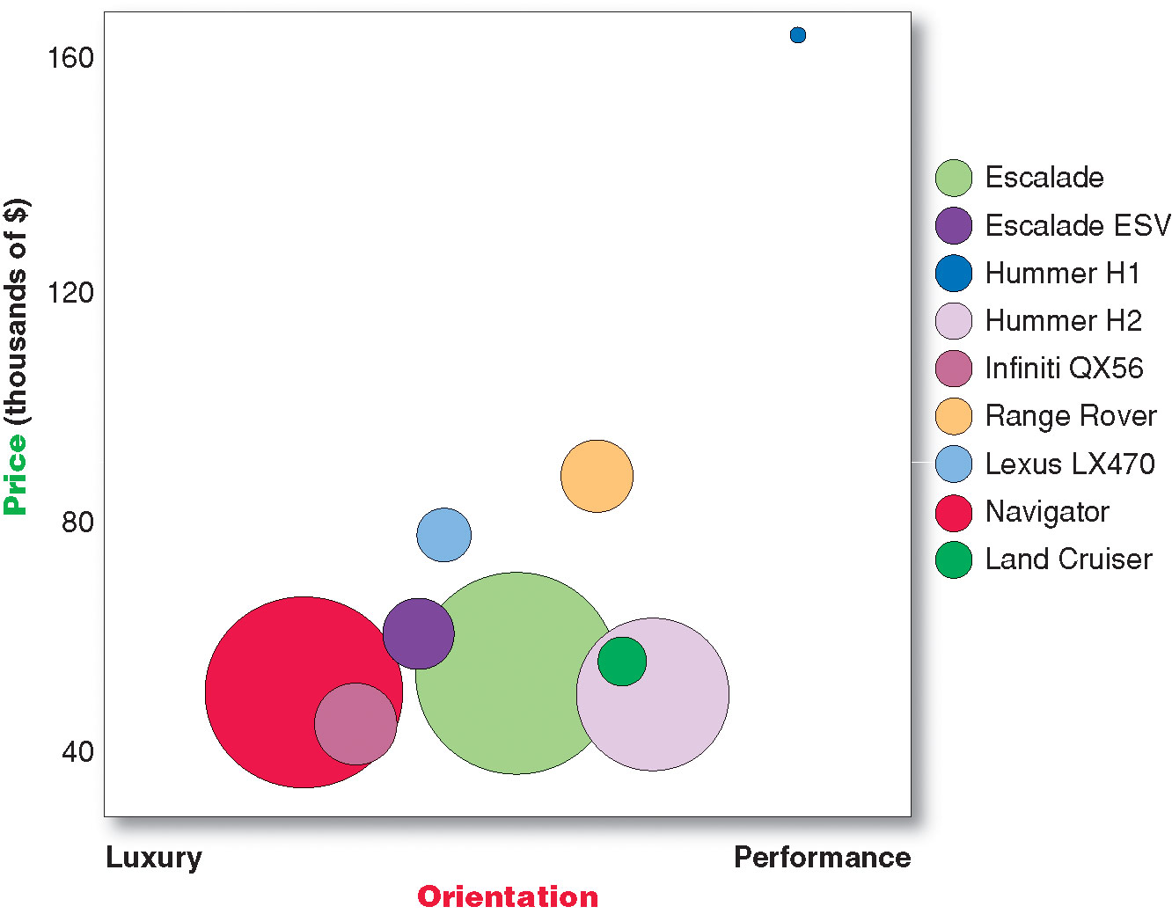
Differentiation and Positioning
Positioning maps show consumer perceptions of their brands versus competing products on important buying dimensions

Slide 34
Differentiation and Positioning
Choosing a Differentiation and Positioning Strategy
Identifying a set of possible competitive advantages to build a position
Choosing the right competitive advantages
Selecting an overall positioning strategy
Developing a positioning statement

Slide 35
Differentiation and Positioning
Identifying Possible Value Differences and Competitive Advantages
Competitive advantage is an advantage over competitors gained by offering consumers greater value, either through lower prices or by providing more benefits that justify higher prices

Slide 36

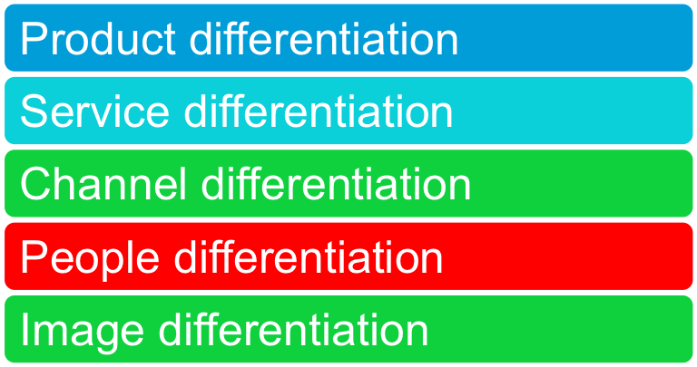
Differentiation and Positioning
Choosing a Differentiation and Positioning Strategy
Identifying a set of possible competitive advantages to build a position by providing superior value from:

Slide 37
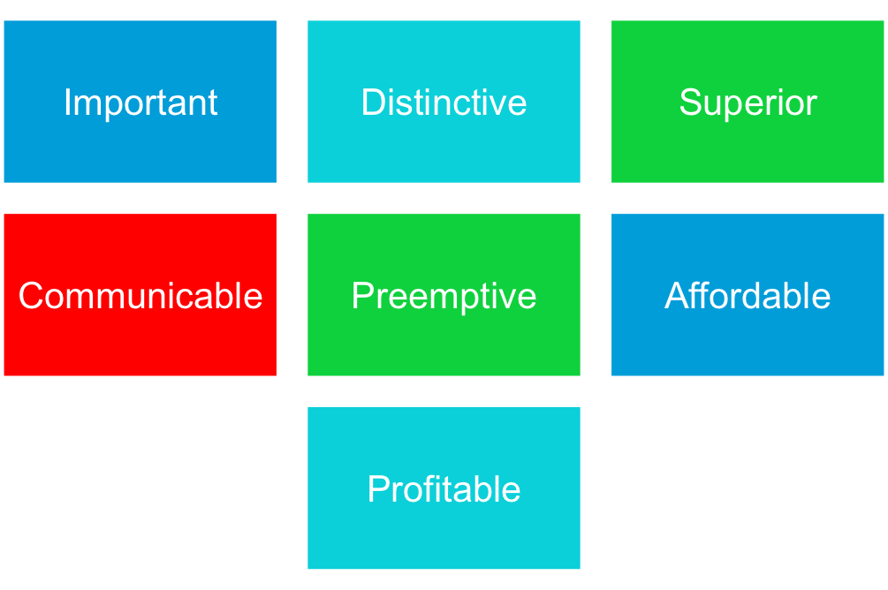
Differentiation and Positioning
Choosing the Right Competitive Advantage
Difference to promote should be:
Notes:
Note to Instructor
Discussion Question
Are you familiar with GEICO advertisements? If so, what is their positioning?
The Web link is to a YouTube ad. The question is what do they promote as their difference. It is that they cost less and they are easy to use. The instructor might want to play competitor’s ads to see what differences they promote (State Farm) is a good example.

Slide 38
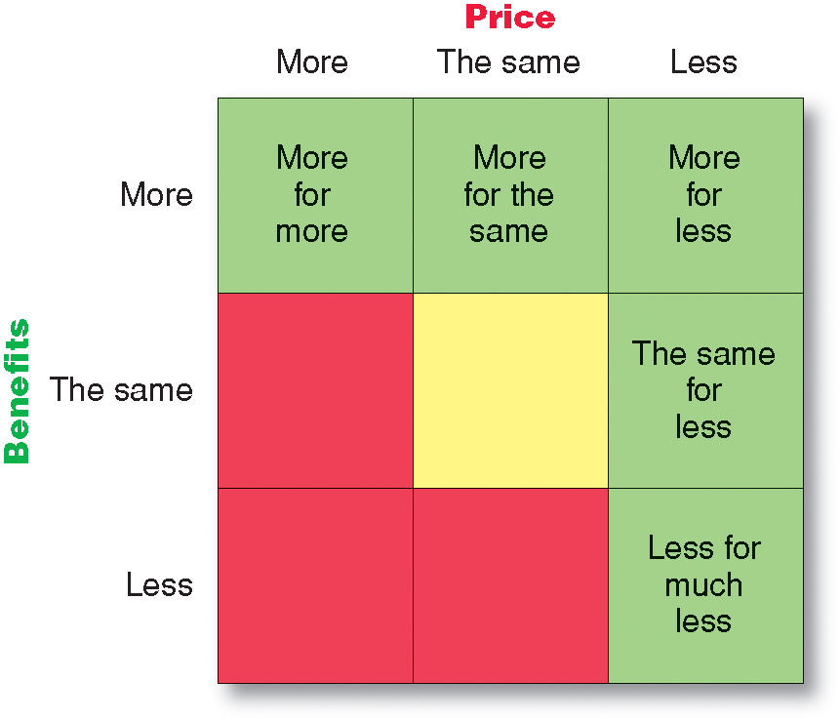
Differentiation and Positioning
Selecting an Overall Positioning Strategy
Value proposition is the full mix of benefits upon which a brand is positioned

Slide 39

Differentiation and Positioning
Developing a Positioning Statement
To (target segment and need) our (brand) is (concept) that (point of difference)
Web link
Notes:
Note to Instructor
Ask this discussion question after watching the ad?
Discussion Question
What is a positioning statement for Verizon?
Verizon positioning is always that they have the best connections in any area.

Slide 40
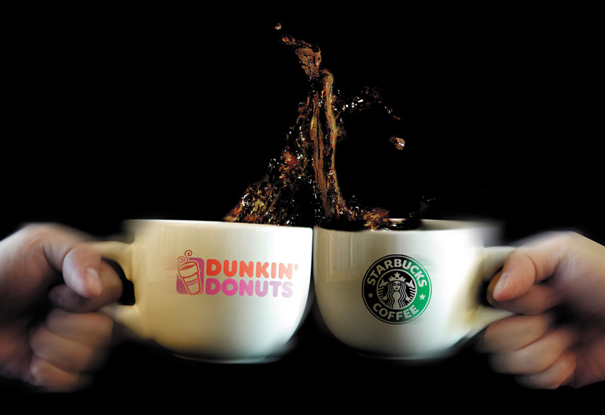
Communication and Delivering the Chosen Position
Choosing the positioning is often easier than implementing the position.

Slide 41
Preview Chapter 8

Slide 42

Product, Services, and Branding Strategy
Topic Outline
What Is a Product?
Product and Services Decisions
Branding Strategy: Building Strong Brands
Services Marketing

Slide 43
In-Class Writing Exercise
Differentiation
Identify “Successful” Product or Service
Determine how it Differentiates Itself from the Competition

Slide 44
Midterm I Review
Look Over Questions, “Learning Opportunity”
If You Thinks a Question Should Be “Examined…
  Take a Notecard
  Write Question Number
  Provide Rationale Why You Think the Question Should be Re-Examined
I Will Review Your Requests and Discuss Results with You Next Class

Slide 45
MKTG 310
See You Next Class!

